Slide 1

ADAPTIVE LEARNING SYSTEMS: AUTOMATIC SEGMENTATION OF STUDENTS BASED ON ONLINE COURSE INTERACTION
GRAPHIC ERA DEEMED TO BE UNIVERSITY, DEHRADUN
BY: RASHIKA TYAGI IV SEM SECTION-A 2021381
PROJECT MENTOR : DR. AMIT KUMAR

Slide 2
PROJECT OVERVIEW
In this project, we have focused on these learning objectives:
Uploading Dataset from Kaggle
Preprocessing the Dataset
Determining the optimal number of clusters
Applying Clustering Algorithm (K-means clustering)
Dimensionality Reduction (Using PCA)
Model Evaluation (Davies Bouldin Index)
Extracting Information

Slide 3
STEP BY STEP PROCEDURE FOR THE PROJECT

Slide 4
STEP - 1 IMPORTING REQUIRED LIBRARIES
Libraries used : -
Matplotlib: For plotting graphs
Pandas : For data manipulation and analysis
Scikit-Learn : For importing modules like sklearn.preprocessing, sklearn.decomposition, sklearn.cluster, sklearn.metrics
Seaborn : Statistical data visualization library based on matplotlib
STEP - 2 IMPORT THE DATASET
Dataset : Courses data from “Kaggle”
The dataset is then decompressed and read into a pandas DataFrame for plotting the target distribution.

Slide 5
STEP - 3 PREPROCESSING
For making the dataset compatible for algorithm
First, handling Missing Values
Second, Encoding Categorical Values (Using LabelEncoder)
Third, Scaling Numerical Features (Using StandardScaler)
STEP - 4 DATA VISUALISATION
Plotting Histograms of each column of the dataset Matplotlib and Seaborn Libraries.

Slide 6
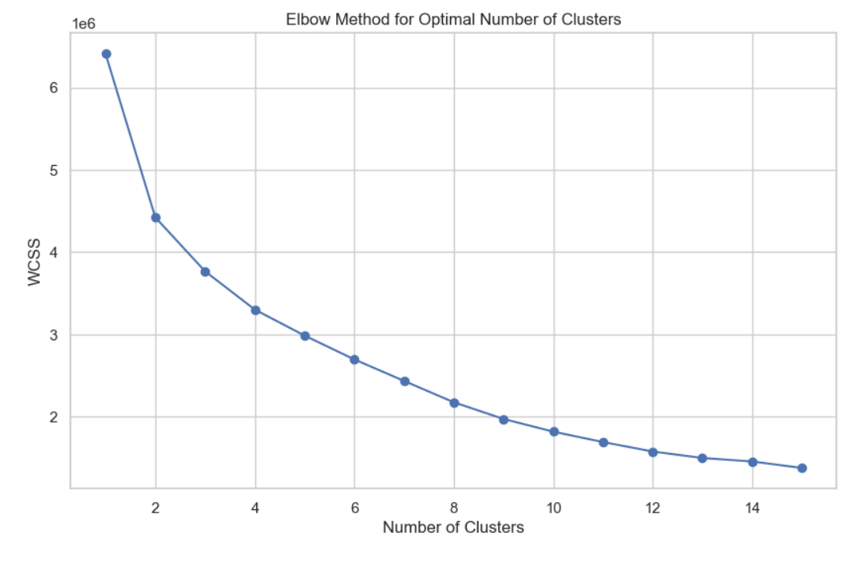
STEP-5 : DETERMINING OPTIMAL NUMBER OF CLUSTERS(ELBOW METHOD)
It involves adapting a pre-trained BERT model to the specific task of detecting and classifying toxic content.
WCSS : An empty list to store the Within-Cluster Sum of Squares (WCSS) for different numbers of clusters.
Plotting the graph to analyze the result of elbow method for optimal number of clusters

Slide 7
STEP-5 : APPLYING CLUSTERING ALGORITHM
Applying K-means clustering algorithm to our dataset using optimal number structures
STEP-6 : DIMENSIONALITY REDUCTION
We will use PCA (principal Component Analysis) class of sklearn.decomposition module to reduce number of features to 2 while retaining as much variance as possible
Now we will plot the graph of PCA results
STEP-7 : MODEL EVALUATION
Now we will Calculate the Davis Bouldin Index to calculate the performance of our clustering algorithm.

Slide 8
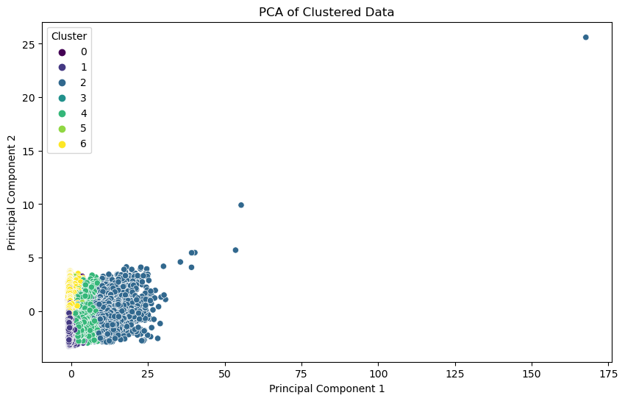
RESULT

Slide 9
FUTURE WORK
REAL TIME DATA : Implement real-time data processing to make the system adaptive in real-time.
INTEGRATION WITH LMS : Integrate the system with popular LMS platforms to seamlessly incorporate the segmentation results and personalized recommendations.
PERFORMANCE PREDICTION : Predict students' future performance and tailor interventions accordingly.

Slide 10
THANK YOU

